Slide 1


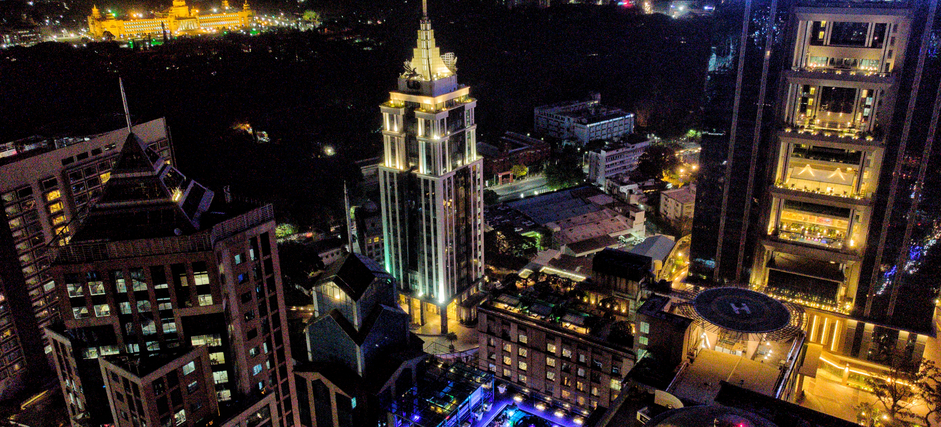
CAPSTONE PROJECT Explore and Compare Hotspots in Bengaluru
By- Vismay Radhakrishnan
15th June 2020

Slide 2

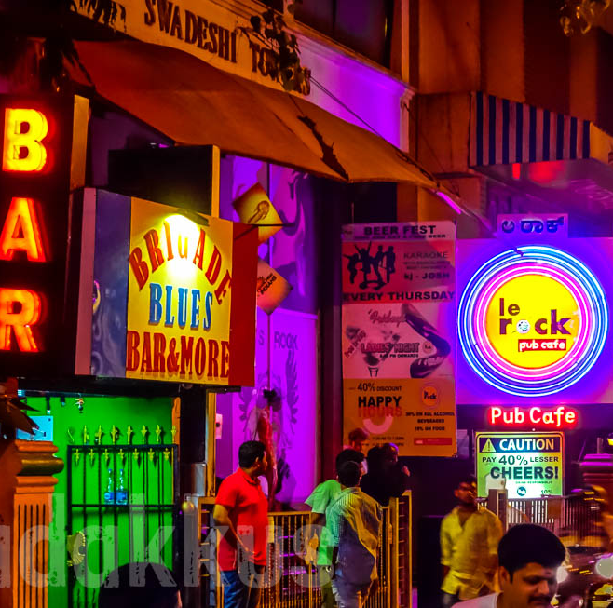
INTRODUCTION
- Explore trends in 3 Key Location
- Analyze the Similarity in venues
- Explore venues as per their Rating
- Distribution of venues across various Price Ranges
- Clustering of venues across the prime locations

Slide 3
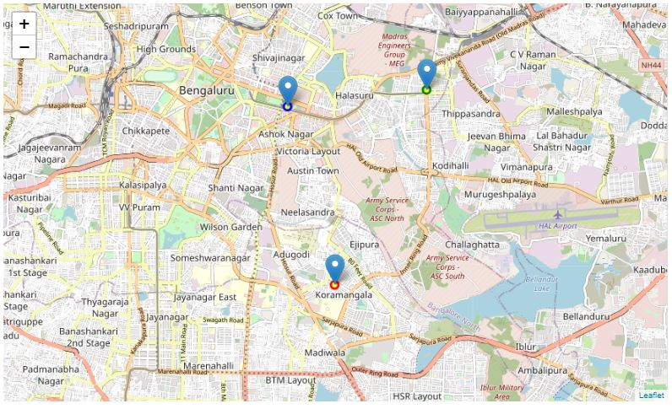

Hotspots in Bengaluru
MG Road
Indiranagar
MG Road
Koramangala
Indiranagar
Koramangala

Slide 4

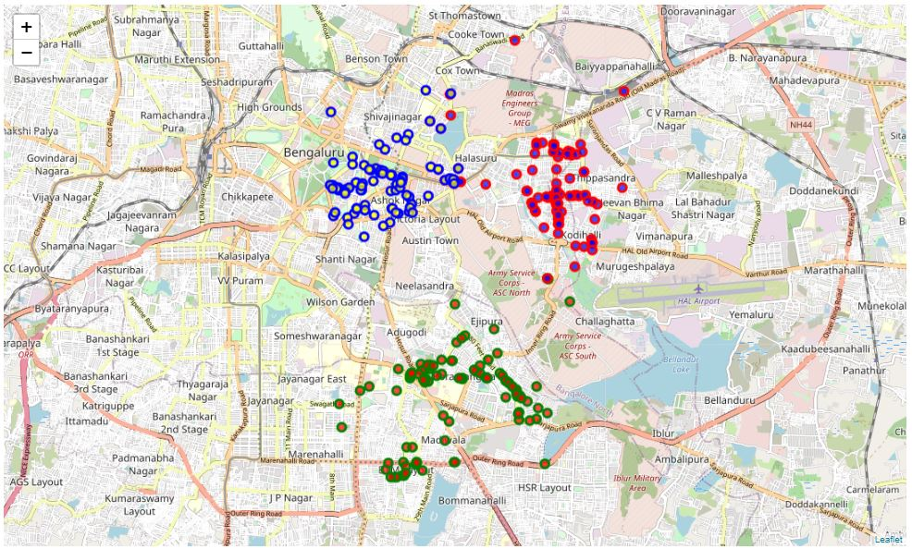
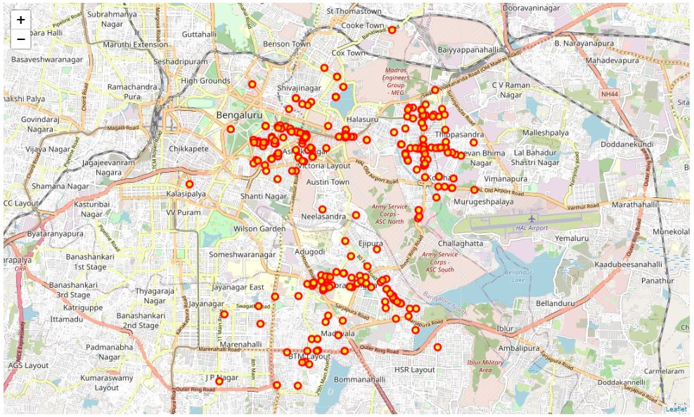
DATA
1. Foursquare API:
Name,
Category,
Latitude,
Longitude
2. Zomato API:
Venue Name,
Address,
Price Range,
Price for 2 people,
Rating,
Latitude,
Longitude

Slide 5
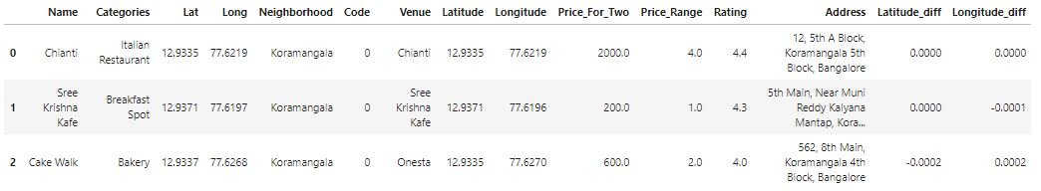
Combined Data
Obtained by combining the data obtained from Foursquare API and Zomato API
- The Venue names obtained from both the API does not match.
- Need to clean the data.

Slide 6
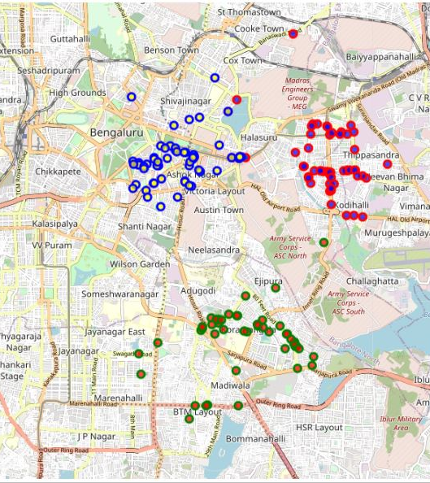
Clean The Data
- Filter venues by difference in Latitude and Longitude values
- Drop the columns with mismatch venues
- Update the old data with newly acquired data
- Initial Data: 300 Venue Details
- Final Data after Cleaning and filtering:
176 Venue Details
- Map plot shows final plotted venues

Slide 7
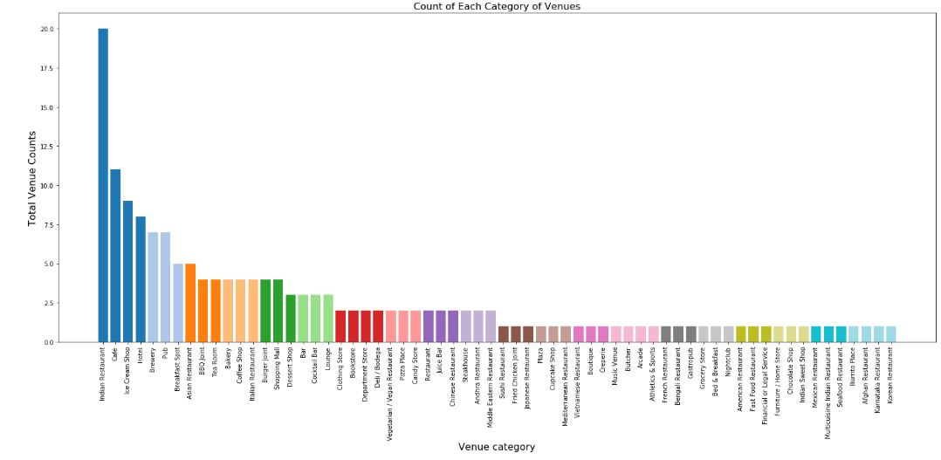
Bar Chart for Total Category Count

Slide 8
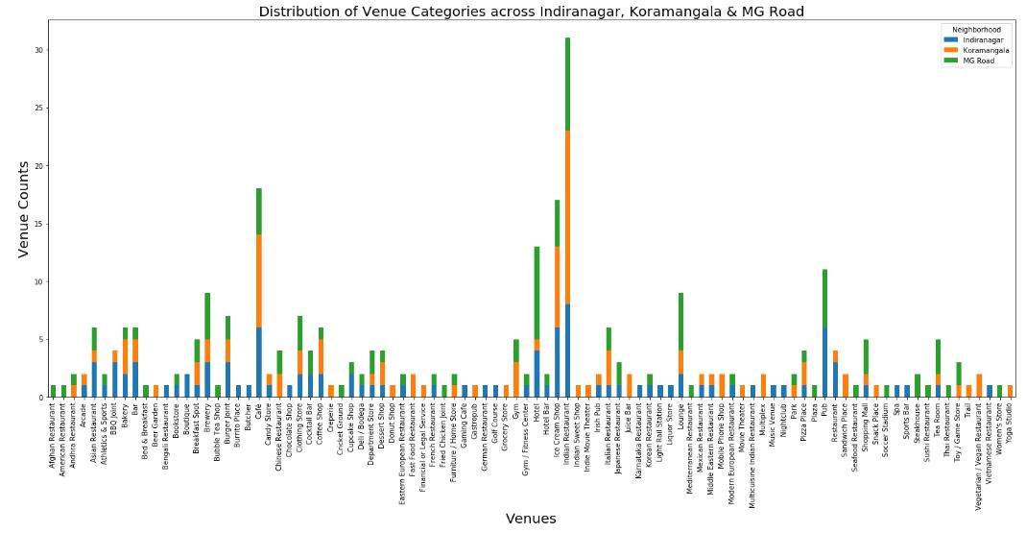
Distribution of Venue Categories across 3 prime locations

Slide 9
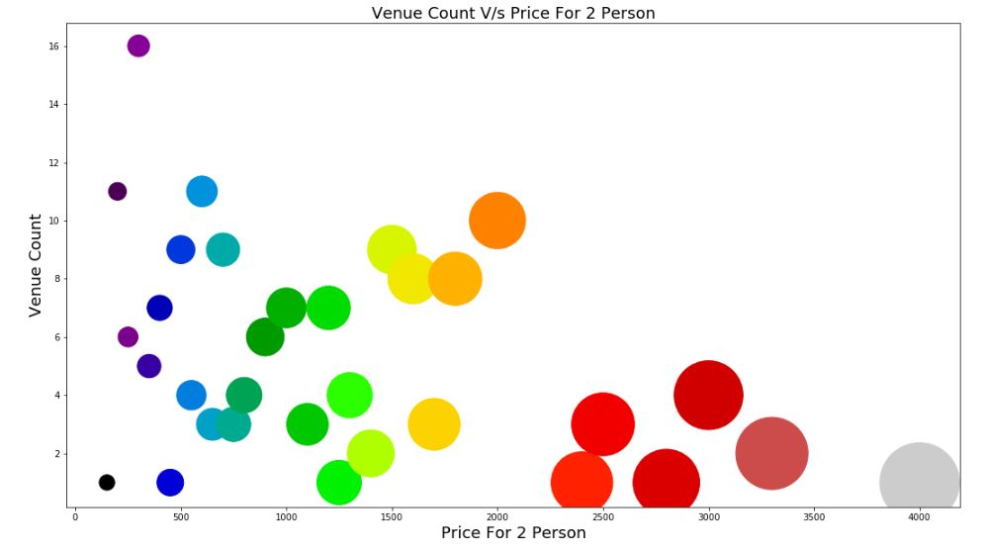
Price Range Distribution

Slide 10
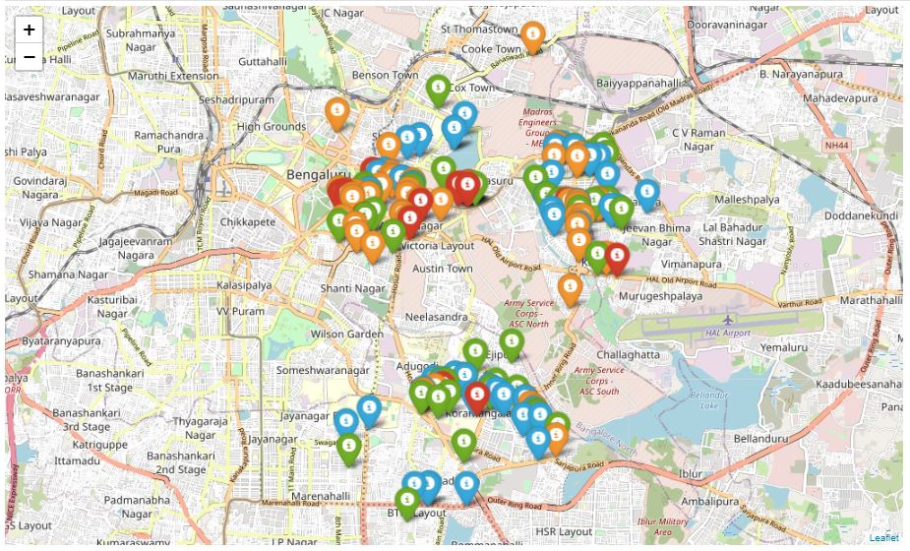
Price Distribution Map

Slide 11
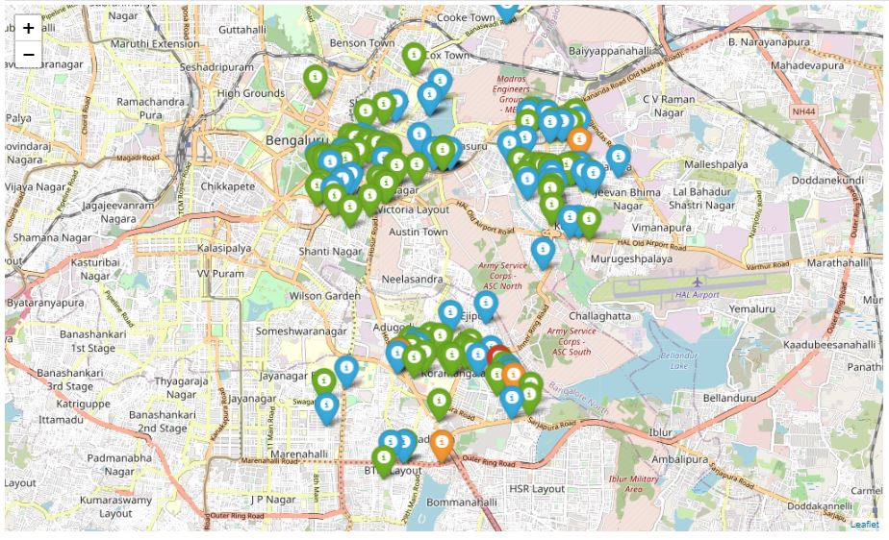

Rating Distribution Map

Slide 12
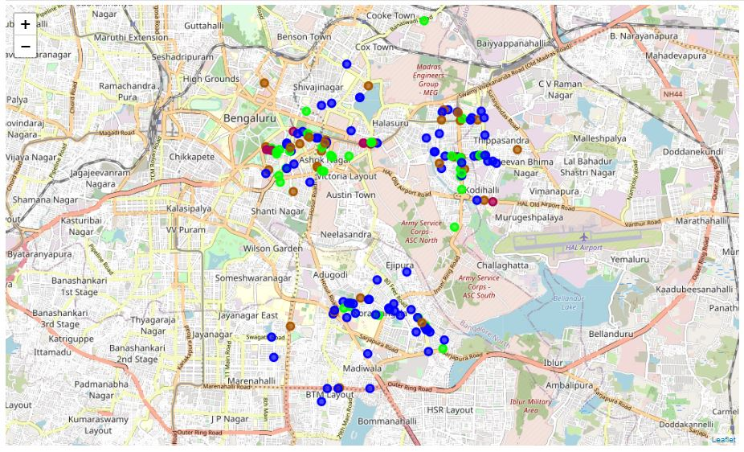
K-Map Clustering

Slide 13
Results and Discussion
MG Road: Premium Hotels, Restaurants, Fine Dine
Popular Destination.
Indiranagar: Mix of High and affordable venues.
Proximity to MG road beneficial.
Koramangala: Affordable and mid-range venues.
Preferred option for people from Electronic City, HSR, BTM, Madiwala.
Most of the places are having Good Rating except few.
The price range distribution of the venues are uneven.
Based on Rating, Location and Average Price, the venues are divided into 4 clusters

Slide 14
Conclusion
The purpose of this project was to explore 3 main places in Bengaluru, which has a lot of potential for businesses as a potential market and for individuals to explore new culinary experience.
The venues were identified using Foursquare API and Zomato API and the same were plotted in maps to understand the trends followed.
Also, we were able to cluster all the venues into 4 clusters using M-Means based on location, rating and price range.
This opens a lot of opportunities for businesses to look for options for investment.
Additionally, for anyone exploring Bengaluru these are the 3 best places to start exploring based on the cuisines and categories of venues available.

